Slide 1


Slide 2
Roadmap of Presentation
AIM AND OBJECTIVE
TKINTER AND ITS VARIUOS FUNCTIONS AND USES
NUMPY MODULE
PANDAS MODULE FOR DATA WRANGLING
VISULAISTION , USING MATPLOTLIB
PROJECT DEMONTRATION AND CODE ANALYSIS

Slide 3
DATA VISUALISATION OVERVIEW
Aim: To perform data wrangling and data visualization.
Objective:
To import desired data-set.
To display data-set in tabular form.
To display information which includes column_names, no_of_NaN_values and data_type of respective columns.
Perform data wrangling i.e drop_column, drop_row, add_dummy_column etc
To perform data normalization
To visualize data on different graphs plot and pie-charts.
tkinter | to create window and import built-in widgets i.e Button, optionmenu
matplotlib | to visualize data on to graphs and pie charts i.e. bar graph
re | to match pattern
pandas | for data wrangling i.e drop_column, drop_rows , add_dummy
numpy | to normalize data
tkintertable | to put data-set on canvas embedded on tkinter table

Slide 4
TKINTER MODULE
Tkinter is the standard GUI library for Python.
Creating a GUI application using Tkinter is an easy task. All you need to do is perform the following steps −
Import the Tkinter module.
Create the GUI application main window.
Add one or more of the above-mentioned widgets to the GUI application.
Enter the main event loop to take action against each event triggered by the user.
Tkinter also offers access to the geometric configuration of the widgets which can organize the widgets in the parent windows. There are mainly three geometry manager classes class.
pack() method: It organizes the widgets in blocks before placing in the parent widget.
grid() method: It organizes the widgets in grid (table-like structure) before placing in the parent widget.
place() method: It organizes the widgets by placing them on specific positions directed by the programmer.

Slide 5
PANDAS MODULE
Pandas is the most popular python library that is used for data analysis.
It provides highly optimized performance with back-end source code is purely written in C or Python.
We analysis data in pandas with:
Series (1-d array)
Data Frame (2-d array)
Using Pandas, we can accomplish five typical steps in the processing and analysis of data, regardless of the origin of data – load, prepare, manipulate, model and analyse.

Slide 6
NUMPY MODULE
NumPy (Numeric Python) is a linear algebra library for python.
NumPy enriches the programming language Python with powerful data structure for efficient computation of multi-dimensional arrays and matrices.
A NumPy array is a grid of values, all of the same types, and is indexed by a tuple of nonnegative integers.
The number of dimensions is the rank of the array; the shape of an array is a tuple of integers giving the size of the array along each dimension.

Slide 7
MATPLOTLIB MODULE
Matplotlib:
Matplot.lib is the most popular python plotting library.
It is a low-level library with a Mat lab like interface which offers lots of freedom at the cost of having to write more code.
Matplot.lib is specifically good for creating basic graphs like line charts, bar charts, histograms and many more.
Can be imported as Import matplot.lib pie plot as plat.
Different plots in matplot.lib:
Scatter plot
Plot
Histogram
Bar chart

Slide 8
DATA WRANGLING AND NORMALIZATION
Data wrangling refers to the process of cleaning, restructuring and enriching the raw data available into a more usable format.
DISCOVERING
STRUCTURING
CLEANING
ENRICHING
VALIDATING
PUBLISHING
Data normalization : It is essentially a type of process wherein data within a database is reorganized in such a way so that users can properly utilize that database for further queries and analysis. Data normalization gets rid of a number of anomalies that can crop up from deleting data, inserting more information, or updating existing information.

Slide 9
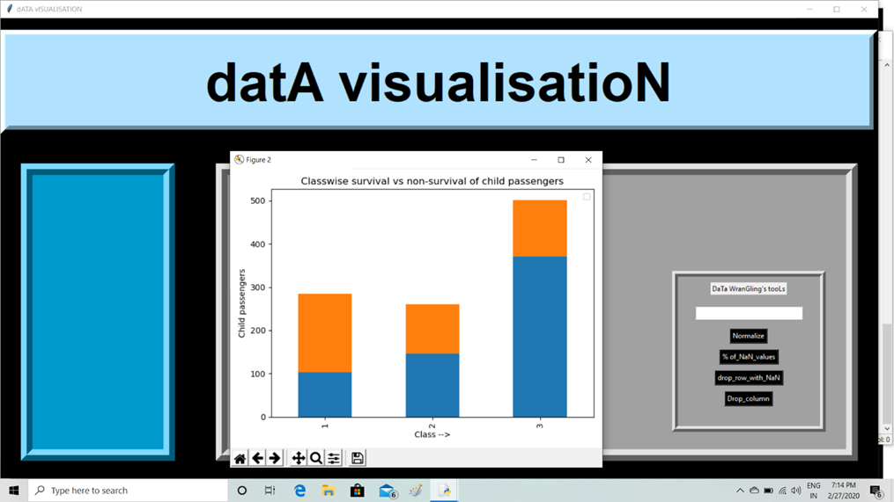
CLASSWISE SURVIVAL vs NON SURVIVAL OF CHILD PASSENGERS

Slide 10
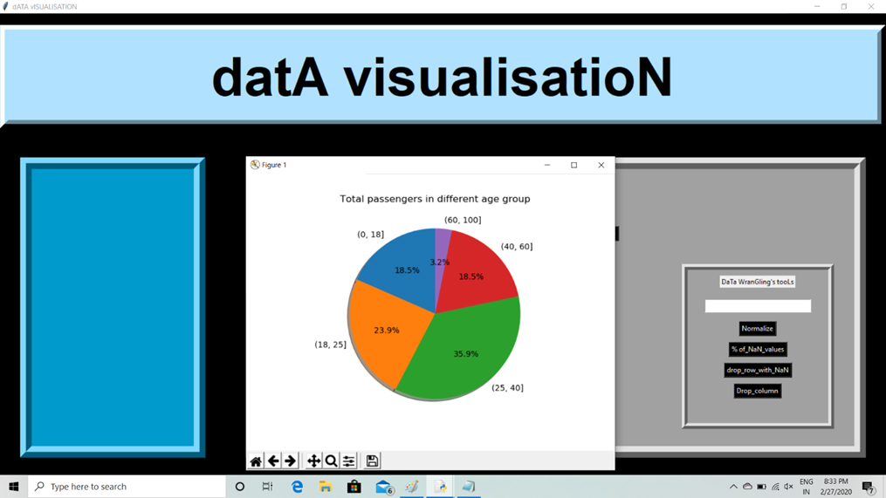
TOTAL PASSENGERS IN DIFFERENT AGE GROUPS

Slide 11
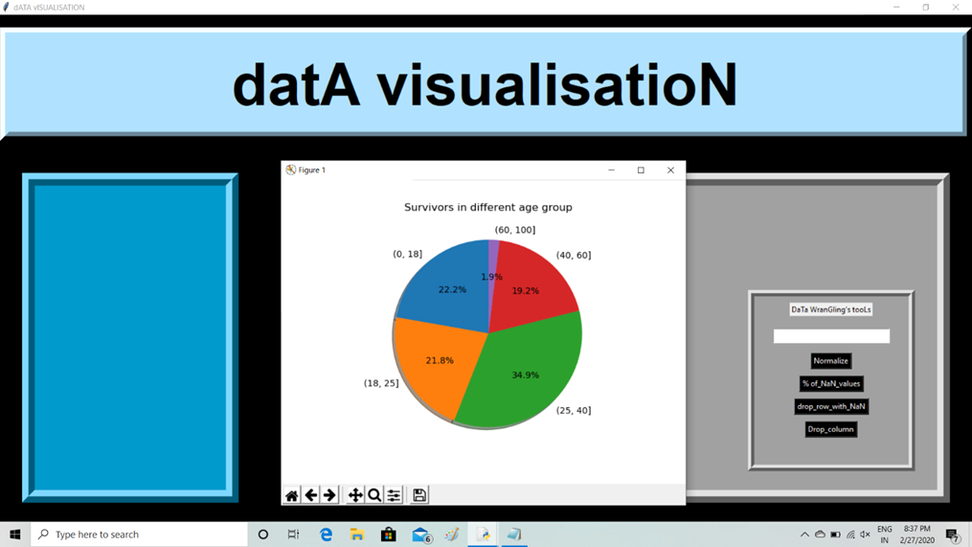
SURVIVORS IN DIFFERENT AGE GROUPS

Slide 12
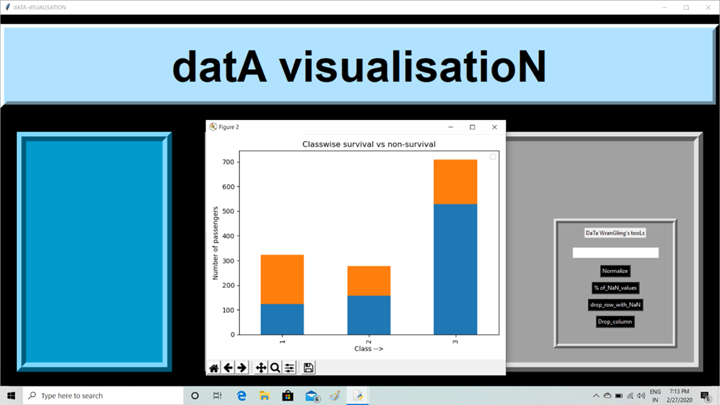
CLASSWISE SURVIVAL vs NON SURVIVAL OF PASSENGERS

Slide 13
CONCLUSION
In “Data Visualisation of Titanic(.csv) Data-Set” project, we were asked to perform data wrangling ,normalization and data visualisations.
During the process of project preparation I and my whole team put tremendous effort in developing a dynamic tool for analysing a given dataset. In our project we incorporated following stuffs:
Functionality of adding any dataset using file_ dialog _menu.
Plotting a different types of graphs using option menu.
It has provision of dynamically dropping column, rows etc.
It also includes buttons to display dataset in tabular format.
We accomplish above mentioned functionality using several modules like tkinter, matplotlib, re, numpy, pandas, tkintertable etc along with various build in methods like drop(),grid(),pack() ,plot() etc.

